Slide 1
Network Intrusion Detection Combined Hybrid Sampling With Machine Learning
Md. Ismail Hossain
Md. Sadiqul Amin

Slide 2
Our Proposal
In our proposed method we will use hybrid sampling on our data set to make our dataset balanced then we will use different machine learning models and compare them. Our goal is to improve the accuracy and time complexity.
Data set
Hybrid Sampling
Machine Learning Model

Slide 3
Our Work
Data Set: NSL KDD
Hybrid Sampling: (SMOTE + OSS)
Machine Learning Model: Support Vector Machine (SVM)
Data Set
(NSL KDD)
Hybrid Sampling
(SMOTE + OSS)
Machine Learning Model
(SVM)

Slide 4
Our Work
Hybrid Sampling
Data set NSL KDD
Majority
Minority
Under Sampling (OSS)
Over Sampling
(SMOTE)
Balanced Dataset

Slide 5
Data Set (NSL KDD)
Kddcup.names
training_attack_types
KDDTrain+.txt

Slide 6
Data Extraction
Fetching data
Load data:
from google.colab import files uploaded = files.upload()
Read Data:
with open("training_attack_types", 'r') as f:
print(f.read())

Slide 7
Data Extraction
The data set doesn't include column names, so let's add them.
columns = (['duration' ,'protocol_type' ,'service' ,'flag’ , 'src_bytes' ,'dst_bytes' ,'land' ,'wrong_fragment' ,'urgent' ,'hot' ,'num_failed_logins’ , 'logged_in' ,'num_compromised' ,'root_shell' ,'su_attempted' ,'num_root' ,'num_file_creations’ , 'num_shells' ,'num_access_files' ,'num_outbound_cmds' ,'is_host_login' ,'is_guest_login' ,'count’ , 'srv_count' ,'serror_rate' ,'srv_serror_rate' ,'rerror_rate' ,'srv_rerror_rate' ,'same_srv_rate' ,'diff_srv_rate' ,'srv_diff_host_rate’ , 'dst_host_count' ,'dst_host_srv_count' ,'dst_host_same_srv_rate' ,'dst_host_diff_srv_rate' ,'dst_host_same_src_port_rate' ,'dst_host_srv_diff_host_rate’ , 'dst_host_serror_rate' ,'dst_host_srv_serror_rate' ,'dst_host_rerror_rate' ,'dst_host_srv_rerror_rate' ,'attack' ,'level’])
df.columns = columns test_df.columns = columns

Slide 8
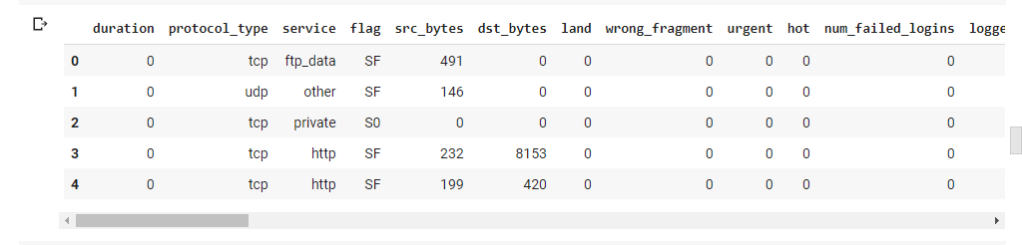
Data Extraction
Training data after adding class

Slide 9
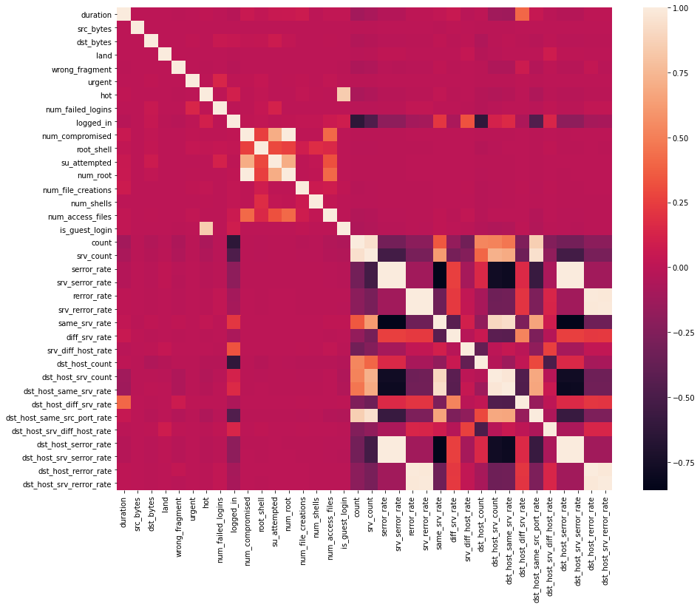
Data preprocessing
Data Correlation – Find the highly correlated variables using heatmap and ignore them for analysis.

Slide 10
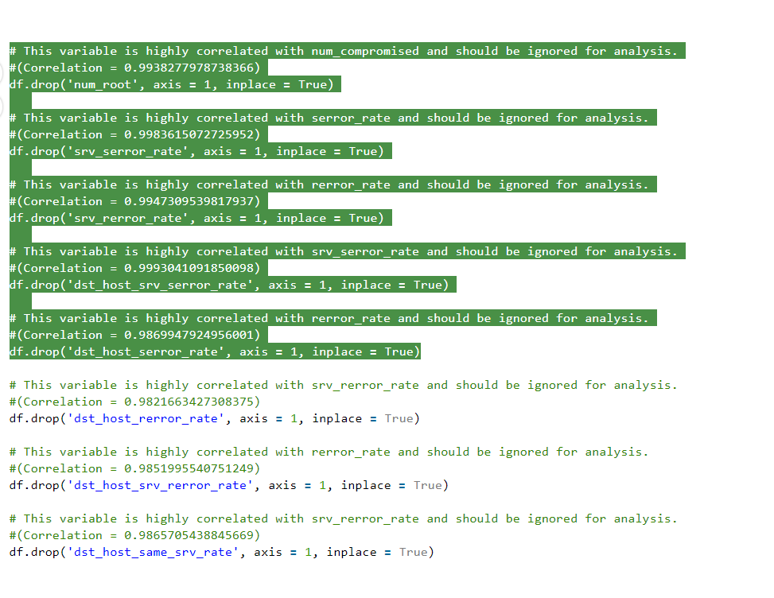
Data Pre processing
Ignoring the highly correlated variables

Slide 11
Feature engineering
Feature Mapping – Apply feature mapping on features such as : ‘protocol_type’ & ‘flag’.
# protocol_type feature mapping
pmap = {'icmp':0, 'tcp':1, 'udp':2}
df['protocol_type'] = df['protocol_type'].map(pmap)
# flag feature mapping
fmap = {'SF':0, 'S0':1, 'REJ':2, 'RSTR':3, 'RSTO':4, 'SH':5, 'S1':6, 'S2':7, 'RSTOS0':8, 'S3':9, 'OTH':10}
df['flag'] = df['flag'].map(fmap)

Slide 12
Splitting the data set
Train data set 67%
Test data set 33%
# Split test and train data
X_train, X_test, y_train, y_test = train_test_split(X, y, test_size = 0.33, random_state = 42)
print(X_train.shape, X_test.shape)
print(y_train.shape, y_test.shape)
(125973, 32) (84401, 31) (41572, 31) (84401, 1) (41572, 1)

Slide 13
Hybrid sampling
Hybrid Sampling using SMOTE and OSS
Data set NSL KDD
Majority
Minority
Under Sampling (OSS)
Over Sampling
(SMOTE)
Balanced Dataset

Slide 14
Synthetic Minority Oversampling Technique (SMOTE)
Nitesh Chawla, et al. in their 2002 paper
In Imbalance data set too few examples of the minority class for a model to effectively learn the decision boundary.
ne way to solve this problem is to oversample the examples in the minority class. This can be achieved by simply duplicating examples from the minority class in the training dataset prior to fitting a model. This can balance the class distribution but does not provide any additional information to the model.

Slide 15
One sided selection (OSS)
Under sampling technique
Use Tomek Links and the condensed Nearest Neighbor
us to remove redundant examples from the interior of the density of the majority class.

Slide 16
Model Fit
Support Vector Machine (SVM)
#SVM
#Import svm model
from sklearn import svm
#Create a svm Classifier
clf = svm.SVC(kernel='linear') # Linear Kernel
print(y_train_hyb.shape)
print(X_train_hyb.shape)
start_time = time.time()
clfg.fit(X_train_hyb, y_train_hyb.ravel())

Slide 17
Result
Time:
Training time: 0.19417929649353027
Testing time: 0.02473306655883789
Accuracy:
Train score is: 0.9003828866322624
Test score is: 0.8930049071490426

Slide 18
Result comparison
Feature | Existing work | Our work
Data set | NSL KDD | NSL KDD
Sampling Technique | Hybrid Sampling(SMOTE + OSS) | Hybrid Sampling(SMOTE + OSS)
ML model | CNN-BiLSTM | SVM
Accuracy | 84.95% | 89.30%

